Slide 1
Non-Math Factors of "I am Not Good at Math"
Jane Chunjing Ji, PhD Candidate
cji@umassd.edu
STEM Education and Teacher Development
University of Massachusetts Dartmouth
Notes:
Hi everyone, it’s such an honor to speak here. My presentation is about the “non-math factors of ‘I am not good at math’”.
Before I start, please allow me to do a brief introduction on myself:

Slide 2
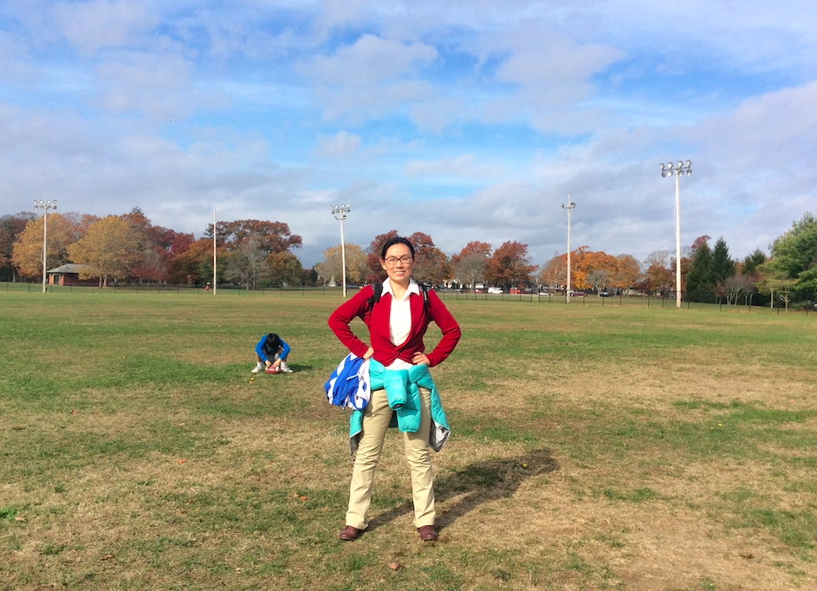
Who Am I?
PhD Candidate
in Mathematics Education
China, P. R.
“Math Person”
a person struggling with math learning and teaching
Math Instructor
MTH 148 College Algebra &
MTH 140 Quantitative Reasoning
Notes:
I am a phd candidate in mathematics education in the department of STEM education and teacher development of UMass Dartmouth. Most of my life was in China. Hearing this, you must think, oh, she must be very good at math. Well, I would accept this as a compliment.
HOWEVER, I am not ALWAYS good at math. On the contrary, in my life I’ve experienced a lot of struggles because of math learning, and TEACHING. So when I introduce myself as a “math person” to my students in math 100 level classes, the real meaning of it ACTUALLY IS “a person struggling with math learning and teaching”. That’s indeed why today I am able to talk about this topic. I am sharing one of my struggles with you.

Slide 3
A Math Problem
When I fueled my car at a gas station yesterday, the price of the regular gas was $2.57 per gallon. At my hometown in China, the price of gas was ￥5.89 per liter. The symbol ￥ means ‘Yuan’, the unit of the Chinese currency, like $ in US. The exchange rate from $ to￥ is 6.88, that is $1 ＝ ￥6.88. Compare the prices in these two places and determine which is more expensive.
[Note in the front page of the test: 1 gallon = 3.8 liters.]
Notes:
Rather than throwing you lots of jargons of learning theories, I decided to ‘hit’ you first by a math problem--this could be more scary, I know, especially if you don’t like math. Let me read this for you, although you may be better than me on reading ☺
This is a problem about unit conversion in MTH 140 Quantitative Reasoning, a general education math course for liberal arts and fine arts students. After we discussed how to do unit conversion in class, I put it in our first in class paper test, as an extra credit question. Using a real life situation about gas, I hoped the familiarity will make the question easier for my students. DO YOU work it out? Need more time? You can have five extra seconds. Do you feel anxious?…

Slide 4
A Math Problem
When I fueled my car at a gas station yesterday, the price of the regular gas was $2.57 per gallon. At my hometown in China, the price of gas was ￥5.89 per liter. The symbol ￥ means ‘Yuan’, the unit of the Chinese currency, like $ in US. The exchange rate from $ to￥ is 6.88, that is $1 ＝ ￥6.88. Compare the prices in these two places and determine which is more expensive.
Answer: The gas in China is more expensive.
Notes:
DO YOU work it out? Need more time? You can have five extra seconds. Do you feel anxious? I hope I didn’t ruin your day… The answer is that in China the gas is more expensive. If you feel unconvinced or so, you are not the only one. Please remember this moment. We will talk about this later. ANYWAY, I was to show my generosity on the test policy by putting this kind of ‘easy’ question as an extra credit problem. HOWEVER, almost all of the class, except several students, did not work it out—they claimed that the gas was more expensive here. They were not like us now, they were with paper, pencil, and calculator, and even the page with all units there to check. With a doubt on their math ability, I went back to their performance of other questions in the test. They actually did much better than this one. One of my struggles came. I reflected on my design of this question.

Slide 5
A Math Problem
CORE: Convert the price of “$2.57 per gallon” to “￥per liter”.
When I fueled my car at a gas station yesterday, the price of the regular gas was $2.57 per gallon. At my hometown in China, the price of gas was ￥5.89 per liter. The symbol ￥ means ‘Yuan’, the unit of the Chinese currency, like $ in US. The exchange rate from $ to￥ is 6.88, that is $1 ＝ ￥6.88. Compare the prices in these two places and determine which is more expensive.
“DRESSING IT UP”
(Schukajlow, Rakoczy, & Pekrun, 2017)
Notes:
What I did is “DRESSING UP” for the core mathematical problem--which is just a unit conversion problem, from a price to another. The method of solving this core problem could apply to conversion of other similar ratio unit, such as, convert the speed 4 feet per second to miles per hour or so. According to literature, I wish the contextualization of the core would help students. HOWEVER It turns out that the dressing up, did not work well. What happened? What did students really THINK AND DO when they encountered this kind of question under a “dress coat”?

Slide 6
A Math Problem
HOW DID STUDENTS TALK ABOUT IT?
“I am not good at math.”
“I just think here should
be more expensive.”
“The gas IS expensive.”
“I pay a lot for gas!”
“I cannot do this.”
……
When I fueled my car at a gas station yesterday, the price of the regular gas was $2.57 per gallon. At my hometown in China, the price of gas was ￥5.89 per liter. The symbol ￥ means ‘Yuan’, the unit of the Chinese currency, like $ in US. The exchange rate from $ to￥ is 6.88, that is $1 ＝ ￥6.88. Compare the prices in these two places and determine which is more expensive.
Notes:
TO ANSWER these questions, I informally talked to several students about how they solved (or not solved but made a claim on) this question. The common responses from them, are, “well, you know, I am not good at math”, “I just think here should be more expensive.” “The gas here IS expensive. You don’t know how much I pay for gas every month”, “I pay a lot for gas…. Do you also pay a lot on that?” “I just cannot do math”…. etc.
WOW, ALMOST NO ONE ACTUALLY is bothered by the math. For me, the math problem is only something that students need to cognitively work on, and I tried to cover the unlovely math by a kind of “dress coat” to make students (and myself) feel better. But I failed, the dress coat did not make it lovely but bring more questions. Were they really not good at math as they thought and claimed? Or were they just confounded by other feelings triggered by the life situation, or the unlovely math core? Struggling with these questions, I learned from my students about the complexity of mathematics learning.

Slide 7
The Complexity of Mathematics Learning
Affective Factors
CORE
Unit Conversion as a Cognitive Activity
(Roth & Walshaw, 2019; Schukajlow, Rakoczy, & Pekrun, 2017)
Notes:
MOST RECENTLY, Literature in mathematics education shows that math learning is much more than the acquisition of mathematical knowledge and skills through cognitive activities. First of all, there are a big variety of affective factors interwoven with cognitive processes, such as feelings of enjoyment, anger, worries, and even anxiety, and attitudes, motivations, etc. —> for example, according to the conversation with students, I feel that the mention of gas payment triggered some of the students’ worries on his/her living cost and then they probably also doubted about why they would spend time and energy on this “silly” math? (but my students usually are very kind and not willing to say this explicitly). Similarly, could you reflect back the moment you just saw the problem and find what feelings you had with it? When you see or hear the numbers, units, and the questions in total, do you feel excited, or your hands in sweat?

Slide 8
The Complexity of Mathematics Learning
Affective Factors
CORE
Unit Conversion as a Cognitive Activity
Bodily Experiences
(de Freitas & Sinclair, 2014)
Notes:
Mathematics learning is more than mental activity, it is also entangled with our bodily experiences with the material world. Those bodily experience may have profound impact on learning, which are traditionally viewed as in human mind. What if we talk about the gas problem in a real gas station instead of on a test paper? Furthermore, in today’s world, my students get along with high technologies much better than me. How do they navigate in the jungle of math, combining traditional lectures, e-textbook or printed textbook, online homework platforms, and then writing test on paper? let alone the social media full of numeracy information and the big variety of apps, calculators and other tools… Math learning is much beyond what happen in one’s mind…

Slide 9
The Complexity of Mathematics Learning
Affective Factors
CORE
Unit Conversion as a Cognitive Activity
Bodily Experiences
Social Factors
(Sfard, 2008)
Notes:
Mathematics learning is not only about individual’s effort; it always subjects to many implicit or explicit social factors and relationships, although both my students and my self not always realize them. Let’s think one more time about the “dressing up” question—the comparison of gas price between here and in China. Would you agree that it is only a math problem? Did it give my student a hard time only because of the math inside? Actually when I design it, I have already embedded my social and cultural network into it. And why many of them claimed that here is expensive? They have already broken the boundary of the math into their understanding of social and economic life brought into forth by the ”dress coat”. The social aspects may not only come from instructor, but also from peers, family or community, and institution…
All in all, when we examine student’s math learning, it is necessary to situate it back to a holistic picture. Traditionally, math learning is only viewed in the core of the cognitive activity, and we tend to attribute students’ disengagement, and weak performance to their “lack of” this or that, and wish they would “try harder”, and “show more efforts” etc. When we do this, we actually fail to notice these various factors and the relationships among them.

Slide 10
The Complexity of Mathematics Learning
Affective Factors
CORE
Unit Conversion as a Cognitive Activity
Bodily Experiences
Social Factors
(Fenwick, Edwards, & Sawchuk, 2015)
Notes:
ALL of those factors, and the complex relationships among them, together with students’ cognitive activities comprise a complex system. Learning happens within the complex system in relation to all those parts to different extents, but could never be reduced into only one of them.
That is, from the perspective of a complexity theory, even though we categorize the types of factors, they never exist separately. In this sense, although students do have and should have individual agency in learning, we should never assume that the agency of an individual student is determinant all the time in their learning, and we should never assume that their struggles are only their business, due to their own deficiency of this or that. THEN HOW should we react to this “fuzzy,” complex learning system? First of all, I think it is important to accept that, we, as instructor, are also part of the fuzziness.

Slide 11
The Complexity of Mathematics Learning--Reactions
Positive
Supportive
Care
(Anderson, 2007; Andersson, Valero, & Meaney, 2015; Gutiérrez, 2013; Schukajlow, Rakoczy, & Pekrun, 2017)
Notes:
With this acceptance, we need always embrace the fuzziness in a positive way--positive assumption, positive feedback, and positive reaction—when we share mathematical knowledge and skills, we also share support and care. In mathematics, we may say, “two negatives make a positive”, BUT in learning and teaching, with our students, this may not be the case. We should be positive. Comparing to students, an instructor is usually in a more powerful position. Although from the perspective of complexity theory, the power itself is not always determinant either, fortunately, a small positive change in power can make a much larger growth, and exponential growth. This is true mathematically.

Slide 12
The Complexity of Mathematics Learning--Reactions
Positive
Supportive
Care
Identity of Being a Positive Math Learner
(Anderson, 2007; Andersson, Valero, & Meaney, 2015; Gutiérrez, 2013; Schukajlow, Rakoczy, & Pekrun, 2017)
Notes:
THE LAST but not least point, what outcome should we expect from the fuzzy complex learning system? I would argue that, More than just mathematical knowledge and skills, which our students can easily find online if they want. We should expect more on the formation of student’s identity in relation to mathematics, that is, their identity of being a positive math learner, instead of a math hater, or a carrier of math anxiety. The identity issue is especially important for our students, in which the majority are from underrepresented group, first generation college students, and other non-dominant background. When they say, “I am not good at math”, “I cannot do math”, they may struggle against much more than the core of the math! I believe that paying more attention to the complexity of the math learning may give us more insights on how to stop reproducing the “not-good-at-math” learner and how to help our students pass through the gatekeeper of math.
Extra—if there is still time left—how to examine students’ mathematical identity? Research shows that the following are helpful: instruments such as questionnaire or survey, writing autobiography about their experience about mathematics, narrative stories from interview etc. THIS COULD SERVE AS THE SUPPLEMENT (NOT REPLACEMENT) OF TRADITIONAL CLASS PROJECT AND HOMEWORK

Slide 13
References
Anderson, R. (2007). Being a mathematics learner: Four faces of identity. Mathematics Educator, 17(1), 7-14. https://eric.ed.gov/?id=EJ841557
Andersson, A., Valero, P., & Meaney, T. (2015). “I am [not always] a maths hater”: Shifting students’ identity narratives in context. Educational Studies in Mathematics, 90(2), 143-161. https://doi.org/10.1007/s10649-015-9617-z
De Freitas, E., & Sinclair, N. (2014). Mathematics and the body: Material entanglements in the classroom. Cambridge University Press.
Fenwick, T., Edwards, R., & Sawchuk, P. (2015). Emerging approaches to educational research: Tracing the socio-material. Routledge.
Gutiérrez, R. (2013). The sociopolitical turn in mathematics education. Journal for Research in Mathematics Education, 44(1), 37-68. https://www.jstor.org/stable/10.5951/jresematheduc.44.1.0037
Roth, W. M., & Walshaw, M. (2019). Affect and emotions in mathematics education: Toward a holistic psychology of mathematics education. Educational Studies in Mathematics, 102(1), 1-15. https://doi.org/10.1007/s10649-019-09899-2
Schukajlow, S., Rakoczy, K., & Pekrun, R. (2017). Emotions and motivation in mathematics education: Theoretical considerations and empirical contributions. ZDM, 49(3), 307-322. https://doi.org/10.1007/s11858-017-0864-6
Sfard, A. (2008). Thinking as communicating: Human development, the growth of discourses, and mathematizing. Cambridge University Press.

